Slide 1
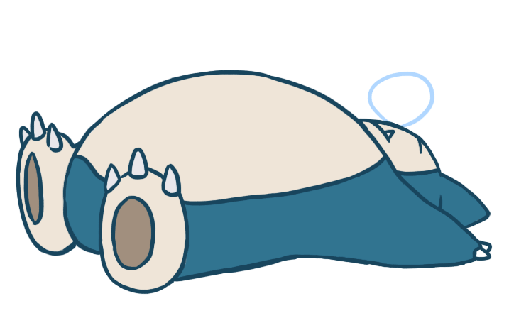
Review the old and learn the new.
Wake up from the holiday!!!!!

Slide 2
Let’s count!

Slide 3
eleven

Slide 4
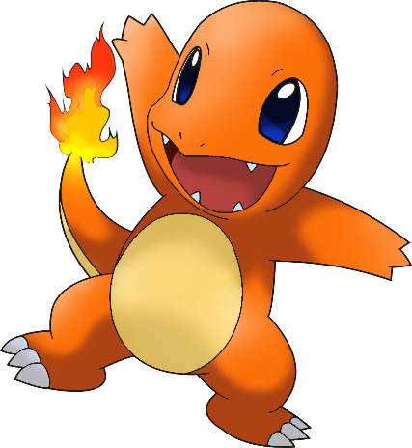
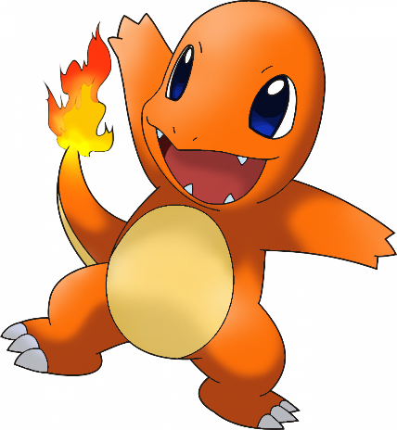
twelve

Slide 5
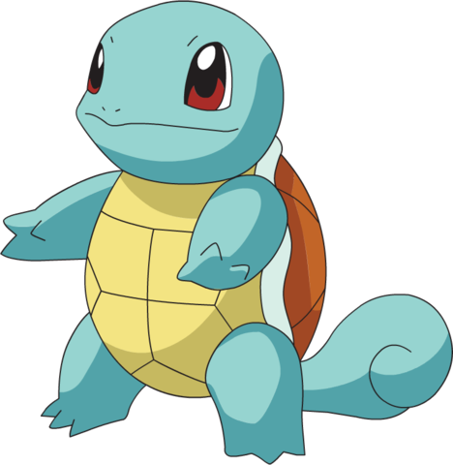
thirteen

Slide 6
fourteen

Slide 7
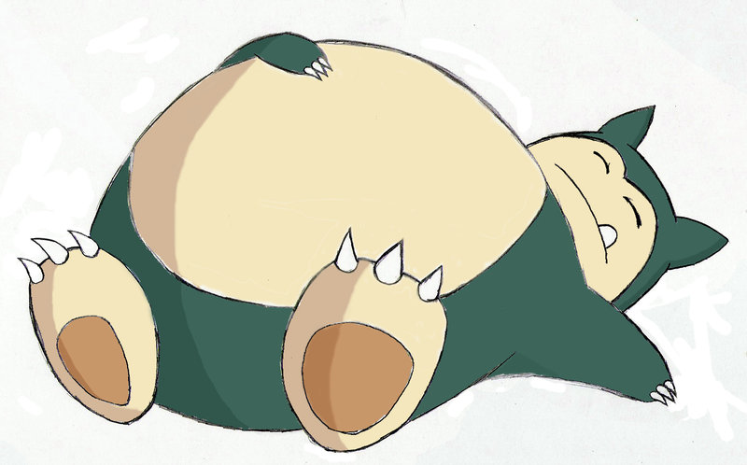
fifteen

Slide 8
sixteen

Slide 9
seventeen

Slide 10
eighteen

Slide 11
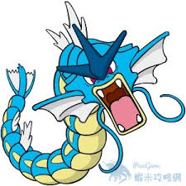
nineteen

Slide 12
twenty

Slide 14
Sentence Practice

Slide 15
Is your brother a cook?
Yes, he is.

Slide 16
Is your sister a student?
Yes, she is.

Slide 17
Is Jolin Tsai a nurse?
No, she isn’t.
She’s a singer.

Slide 18
Is Ke P a teacher?
No, he isn’t.
He’s a doctor.

Slide 19
Is Squirtle a dancer?
No, it isn’t.
It’s a firefighter.

Slide 20
dance
dance

Slide 21
sing
sing

Slide 22
fly
read

Slide 23
jump
draw

Slide 24
swim
swim

Slide 25
roller-skate
ride a bike

Slide 26
Can you _______ ?
Yes, I can.
No, I can’t.
can’t= cannot

Slide 27
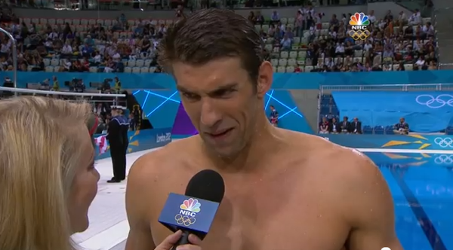
Yes, I can.
I can swim.
Can you swim?

Slide 28
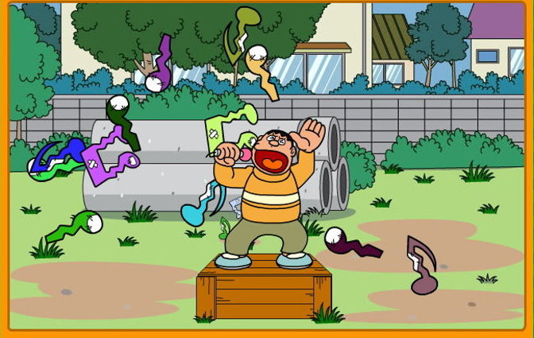
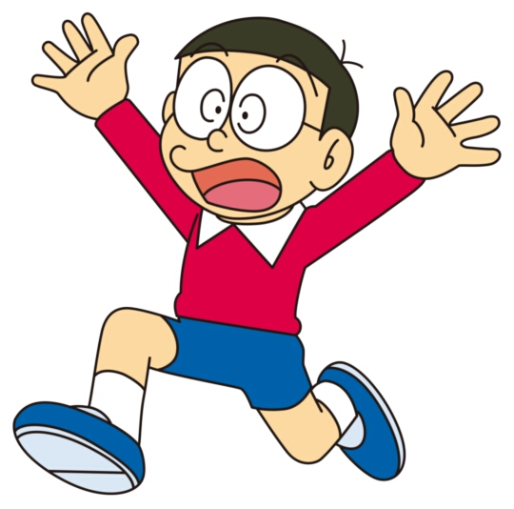
No, I can’t.
I can’t sing.
Can you sing?

Slide 29
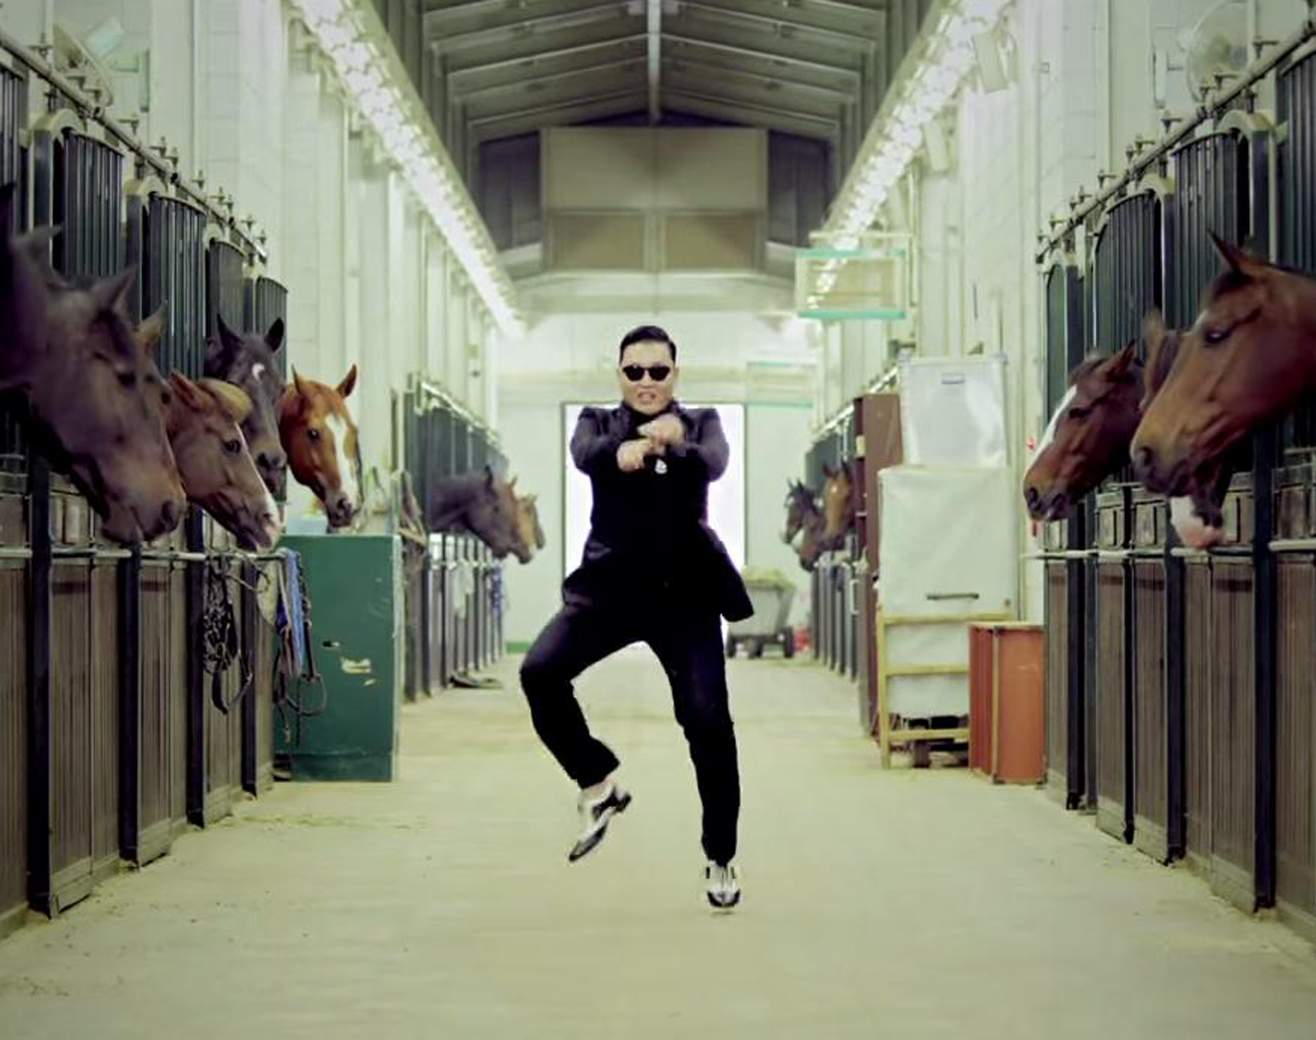
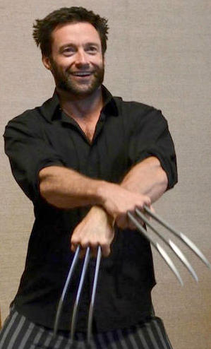
Can you dance?
Of course I can.

Slide 30
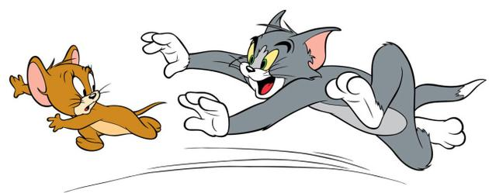
No, I can’t.
I can run.
Can you fly?

Slide 31
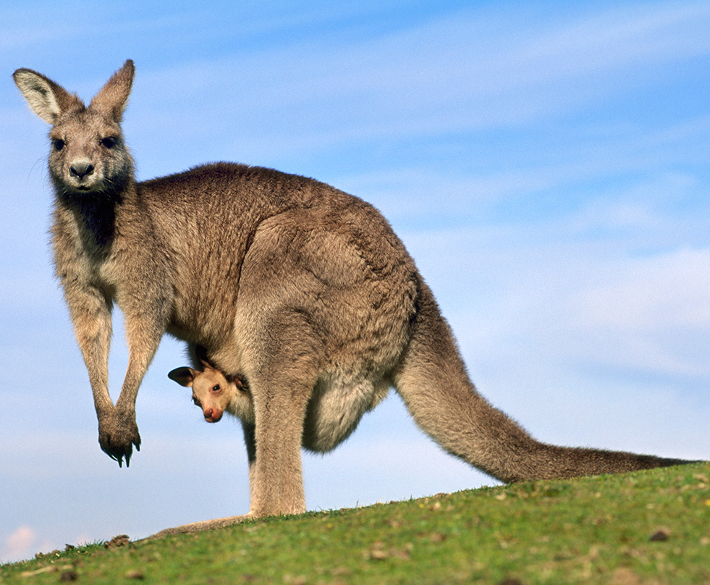
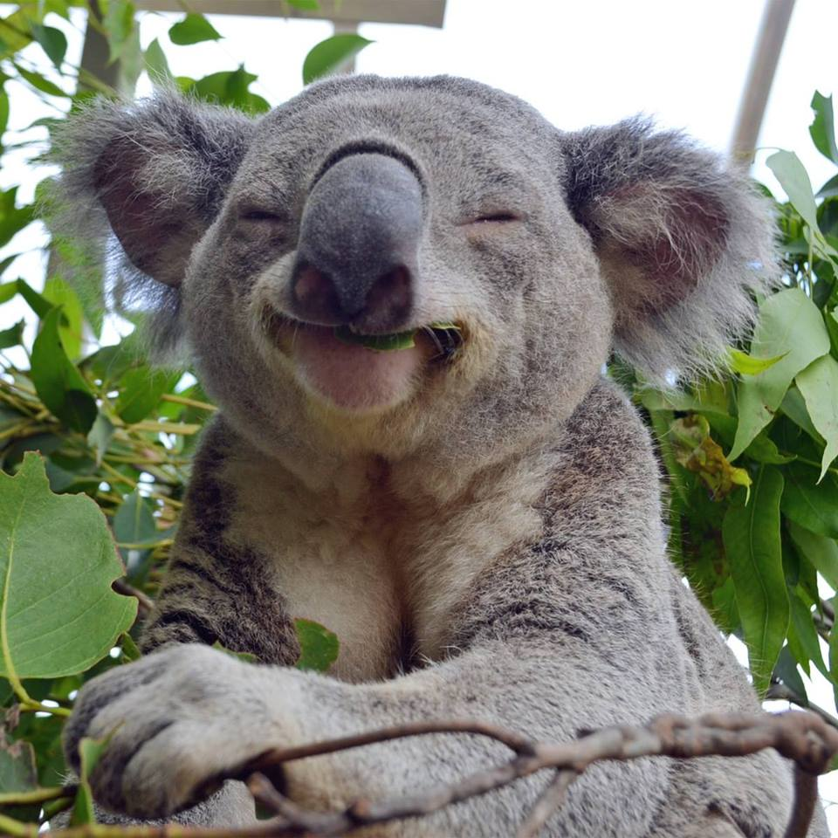
Yes, I can.
Can you?
Can you jump?
No, I can’t jump, but I can sleep.

Slide 32
Weather words

Slide 33
windy
Remove

Slide 34
rainy
Remove

Slide 35
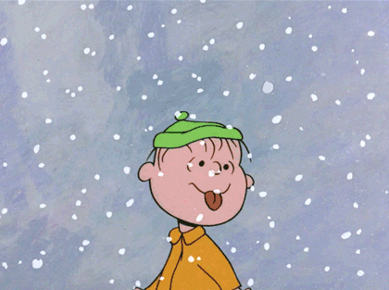
snowy
Remove

Slide 36
cloudy
Remove

Slide 37
sunny
Remove

Slide 38
How’s the weather?
It’s sunny.

Slide 39
How’s the weather?
It’s rainy.

Slide 40
How’s the weather?
It’s windy.

Slide 41
How’s the weather?
It’s cloudy.

Slide 42
How’s the weather?
It’s snowy.

Slide 43
How’s the weather?
It’s stormy.

Slide 44
How’s the weather?
It’s foggy.

Slide 45
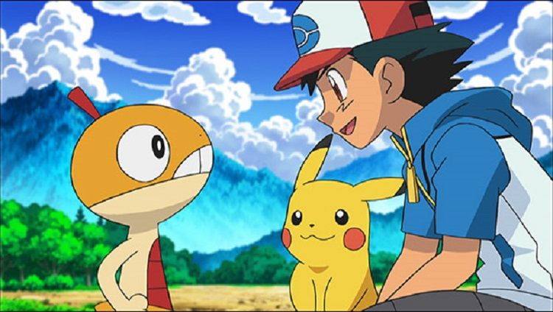
What do you want?
I want ….

Slide 46
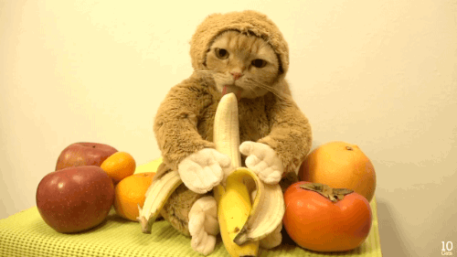
a banana

Slide 47
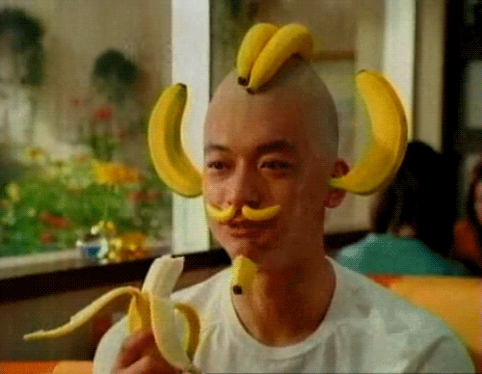
bananas

Slide 48
an apple

Slide 49
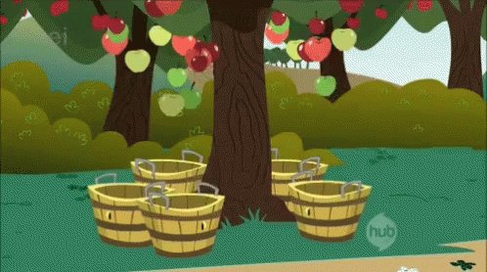
apples

Slide 50
an orange

Slide 51
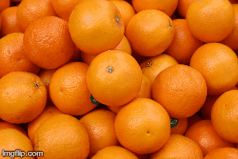
oranges

Slide 52
jump
an egg

Slide 53
jump
eggs

Slide 54
fly
a hamburger

Slide 55
fly
hamburgers

Slide 56
fly
a hot dog

Slide 57
fly
hot dogs

Slide 58
What do you want?
I want a hot dog.

Slide 59
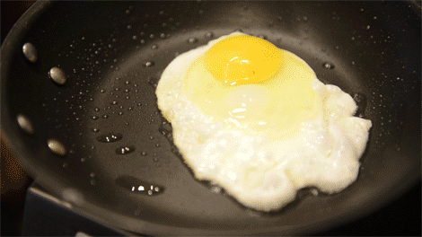
What do you want?
I want an egg.

Slide 60
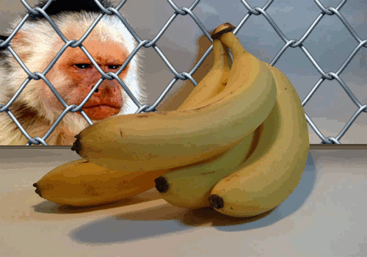
What do you want?
I want four
bananas.

Slide 61
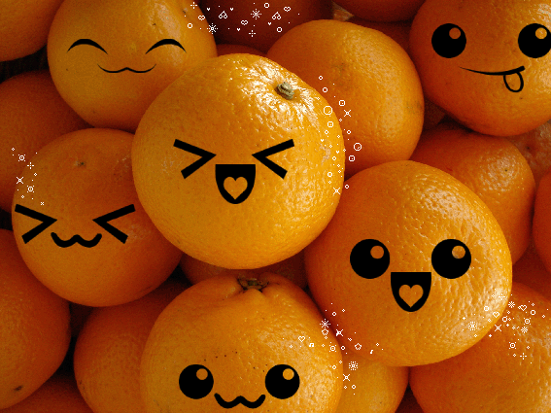
What do you want?
I want many
oranges.

Slide 62
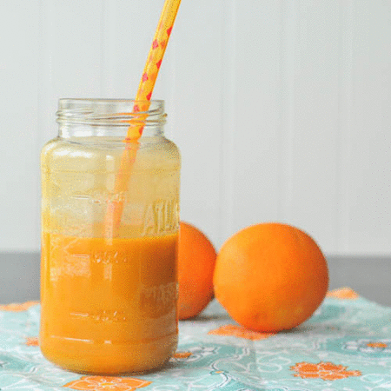
What do you want?
I want some
juice.

Slide 63
What do you want?
I want some
milk.

Slide 64
What do you want?
I want some tea.

Slide 65
Can we count the objects? Countable Uncountable

Slide 66
an orange
Can we count oranges?
two oranges

Slide 67
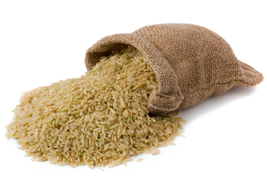
Can we count rice?
some rice

Slide 68
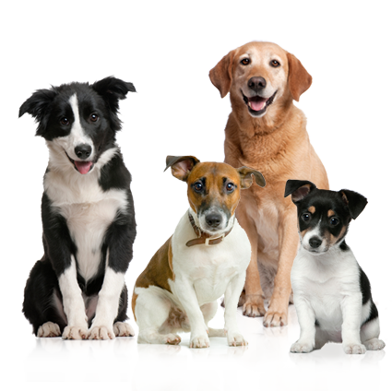
a dog
Can we count dogs?
four dogs

Slide 69
a student
Can we count students?
some students

Slide 70
Can we count water?
some water

Slide 71
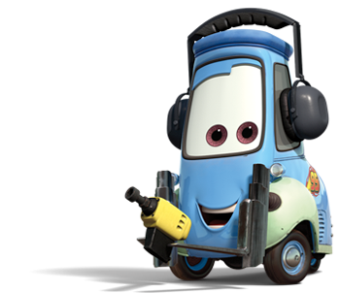
a/an + countable singular nouns an + vowel a + consonant
an orange
a student
a car
a dog

Slide 72
some: affirmative sentences. With uncoutable nouns
some rice
some paint
some water

Slide 73
fly
cake

Slide 74
fly
pizza

Slide 75
fly
ice cream

Slide 76
fly
juice

Slide 77
fly
milk

Slide 78
fly
water

Slide 79
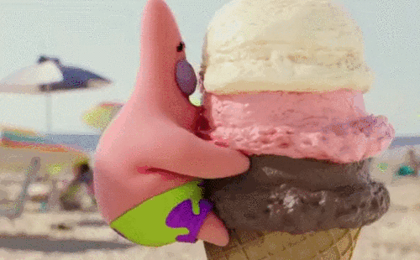
Yes, I do.
Do you like ice cream?

Slide 80
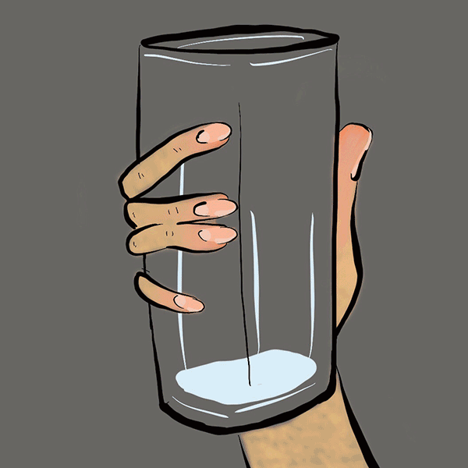
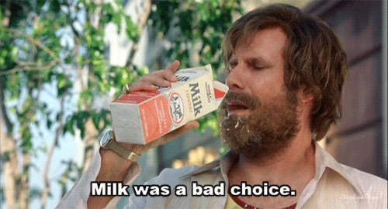
No, I don’t.
Do you like milk?

Slide 81
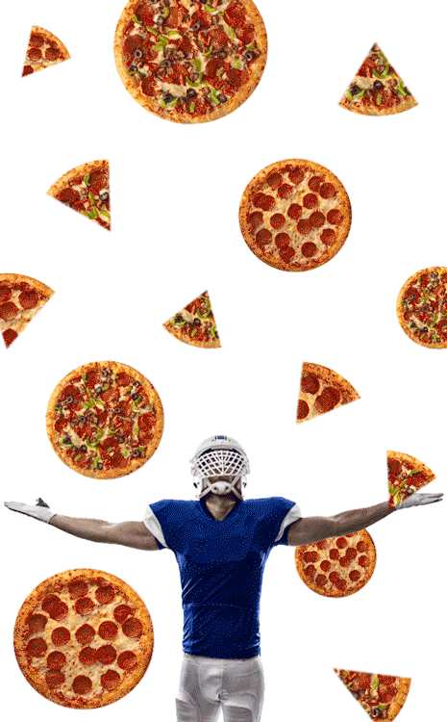
No, I don’t.
I like pizza.
Do you like cake?

Slide 82
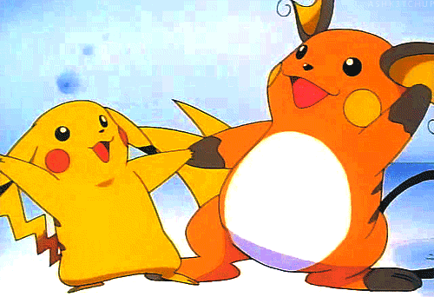
Review the old and learn the new.

Slide 83
Voiced & Voiceless consonants
有聲子音 & 無聲子音

Slide 84
Voiced
Voiceless

Slide 85
Voiced
Voiceless

Slide 86
Voiced
Voiceless

Slide 87
Voiced
Voiceless

Slide 88
Voiced
Voiceless

Slide 90
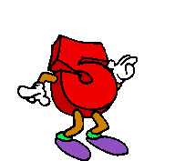
Give me numbers which are bigger than ten.

Slide 91
Give me
food which we
can count.

Slide 92
Give me
food which
we can’t count.

Slide 93
Give me
weather words.

Slide 94
Give me
actions you can do.

Slide 95
Give me
voiced consonants.

Slide 96
Give me
voiceless consonants.

Slide 97
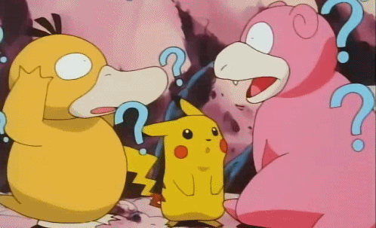
Let’s make new friends
in e-STAR 4!

Slide 98
Listen and write.

Slide 99
Eddy Peggy Iris Adam Oliver Una
________: Hi, everyone! I’m Owen.
This juice is for you.
________: Hi, I’m Owen. I like pizza.
________: Hello, I’m Owen. I like hot dogs.
What about you?
Peggy
Adam
Una

Slide 100
Eddy Peggy Iris Adam Oliver Una
Eddy
________: Hi, I’m Owen. I can help.
What do you want?
________: Hello! My name is Owen.
I like milk and cake.
________: Hi, I’m Owen.
I want a hamburger and some juice.
Iris
Oliver

Slide 101
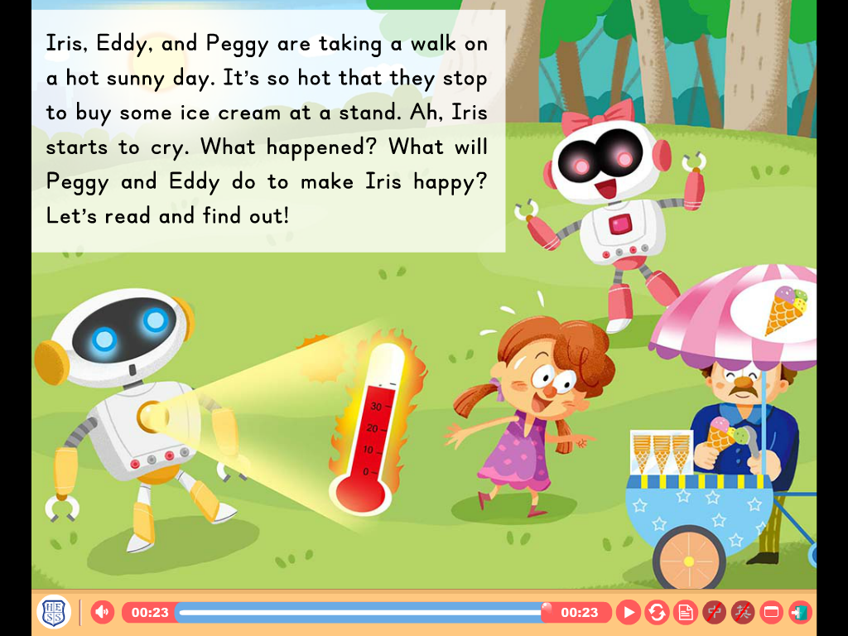

Slide 102
stand攤位/小販
French fries/frit
stand
ice cream stand
Stroop wafel stand
rib & filet stand

Slide 104
Fold it half.

Slide 105
Homework this week
聽: CD1第5-13首。
說&讀:聽CD時跟著大聲唸。完成3遍
請家長在課本P6簽名，可換印章。
寫:英語練習本單字，下週一交。

